Slide 1
Non-Gannakouriep dyke swarm patterns and compositions in the central Richtersveld subprovince , Namibia
By: Atandiwe thandiwe Ndamase
25715518@sun.ac.za

Slide 5

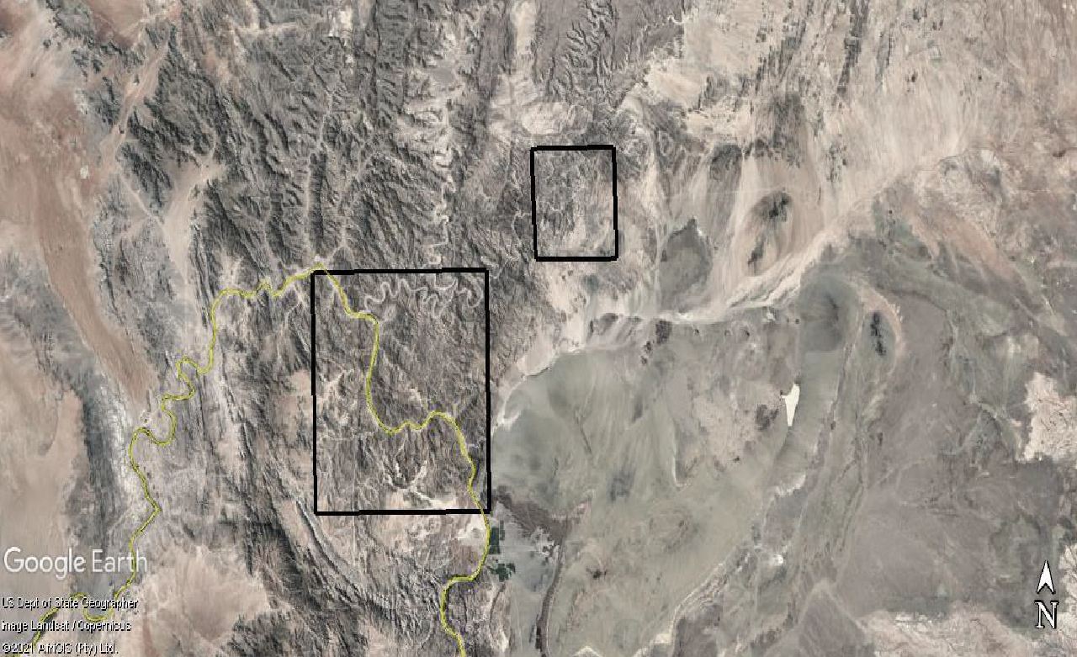
Northeastern Study area
Southwestern Study Area
Map represents two separate areas dykes were sampled
Southwestern Study Area – NE-SW , NW-SE , E-W trending dykes
Northeastern Study Area - NE – SW and NNE-SSW trending dykes
Notes:
Map shows two separate areas in which dykes were sampled , the Southern eastern study area stretches from the Klipheuwel to Grootpensiland , dyke trends NE-SW, NW- SE and E-W
The Northeastern study area stretches located in the Ais-Ais and extends just near the Fish River Canyon, dyke trends NNE-SSW and

